Slide 1
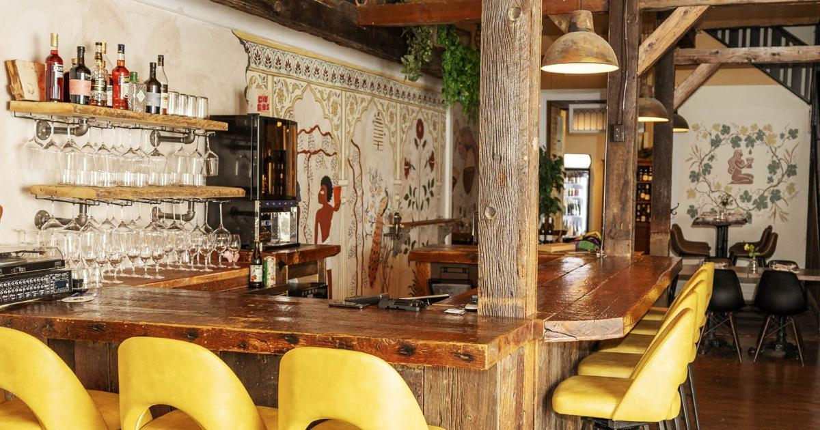
Siris Tasting Room Social
April 30th 6:30pm

Slide 2
Event Premise
A slightly elevated casual mixer
Think of a wine and cheese night
Casual music (asking Jake and Ricardo, unpaid opportunity)
Minimal seating (some available in each room for accessibility) to encourage mingling
Will have a variety of food options (allergies and restrictions accounted for, Chef Kevin is on it)
Will have non-alcoholic drinks as well
Scavenger hunt items can be here
We will have social bingo
Can have other social games like colour coded bracelets for which of the 3 E’s you identify with most, if badges for people looking for collaborations or little networking cards (I have ideas)

Slide 3
Where, When, How
WHERE: Siris Tasting Lounge
WHEN: 6:30pm/7pm start time April 30 2026
Would be right at the end of the keynote
Margarita asked for start time at 6:30 so they are not closed for no reason.
We will need to send volunteers there
HOW: Bus 316 leaves from Brock and stops at James St.
Volunteers and signage for direction
Asking Niagara Transit (again) for bus passes (10 ride pass) as sponsorship (See supplemental slide at end)
If no sponsor the bus is $3.5/ride

Slide 4
Event Structure Options
Partial Booking
< 40 people
Can use the back of the restaurant
No minimum sales required.
Private Booking
> 40 people
Will need to close the whole bar
Minimum sale of $2500
If 40 people that’s $63pp before tax
We need to know an estimate by April 10th
Reem is adding and RSVP to the registration page
Current registrants will be emailed to RSVP
We can go with planning the whole venue option and then scale back if needed

Slide 5
Pricing Options
Best Case Scenario
We get sponsors to take care of the $2500 cost, give everyone one drink and pay for the food, extra drinks are paid for by guests.
Most likely scenario
Guests pay for their own food and drink and we pay nothing because they make $2500 in sales
Worst case scenario
We get a lot of RSVP’s, they don’t come or don’t spend money, we are on the hook for $2500.
Contingency plan on next slide

Slide 6
Contingency plan – Let’s not fail
What if everyone says they’re coming but no one shows up?
We have to pay $2500 and that sucks
How can we prevent this?
Sponsors to cover the event (we are trying)
Sell tickets to cover the event cost (less ideal for guests)
What’s the best option?
Sell tickets to professors and Brock community members who are not registered for the conference but interested in the networking opportunity.
This will not be 100% cost coverage, but it will help
Tickets purchased are a cover charge and do not include alcohol
$10 cover + any money they spend would go toward the $2500 nightly total

Slide 7
Niagara 10 Bus Ride Pass
$31 per pass
Would allow for to and from the conference each day + 4 extra
Downtown to the event on the 30th fits as the “there and back” on the first day
If unable to get these donated by transit, I am putting them on our wish list for sponsors.
People may donate smaller amounts to cover a portion of the costs of passes.

